Slide 1
Computer Vision
Lecture 2
Simon McLoughlin

Slide 2
Overview
Binary Image Analysis
Histograms and Image Thresholding
Binary Morphology
Connected Component Analysis
Region Properties

Slide 3
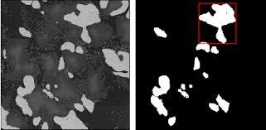
Binary Image Analysis
Many applications in Machine Vision can be solved by producing a binary image from the original and inspecting the resulting regions (e.g. for object recognition or making measurements etc.)
If the binary regions (sometime called BLOBs) represents the original image information well then a solution is likely.
For this reason it is very important to produce the best possible binary image. The use of histograms and thresholding is a common approach to this.

Slide 4

Image Thresholding
Image thresholding is one of the simplest image processing tasks there is.
In its simplest form we use it to convert a grey level image into a binary image depending on whether the pixels are above or below a threshold,t
More formally we can define it as follows
The key to the success of this approach is how we find the threshold,t. Image histograms help to determine this.

Slide 5
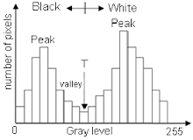
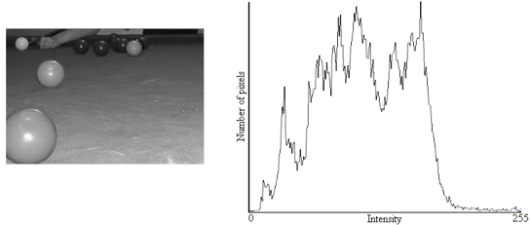
Image Histograms
An image histogram shows us the distribution of grey levels in an image.
Histograms are frequently used in the “image segmentation” process to identify the predominant grey levels in the image.
They show how the grey levels are distributed or divided up in the image range (i.e. 0..255) and frequently a histogram peak will correspond to a foreground object or the image background.

Slide 6
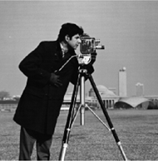
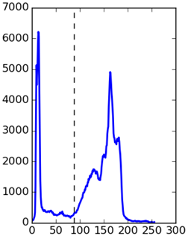

Image Histograms
Histograms in Machine Vision tend to be multi-modal (have a number of peaks). If the distribution is bimodal (2 peaks) then the selection of a threshold is relatively straightforward
Bimodal histograms normally appear where you have two sets of intensities or grey levels, those belonging to the foreground object(s) and those belonging to the background. In this this case we look for the grey level that best separates the two peaks, normally located at the valley between them.

Slide 7
Finding the Threshold, t
This is the most important part of the thresholding, histogramming process!
Assuming we have a bimodal histogram, how do we find the threshold that best separates the peaks?
You could do it empirically by viewing a histogram and noting the grey level in the valley between the peaks but what if the lighting changes? The peaks could shift up or down!
If you know that the foreground is lighter or darker than the background and you know the percentage of the image it occupies you can identify the threshold by summing up the bin counts (starting at 255 if foreground is brighter) until you have included enough pixels to meet the foreground image coverage.
Another approach is to try and identify the local maxima (peaks) and minima (valleys) by looking at how the grey level (GL) counts change along the range. For example you could identify a local maxima by looking at the bin counts either side of one and if they are less then you have found one.
Above approach very susceptible to noise so requires some smoothing of the histogram and typically you will look beyond just one neighbour for the trend.

Slide 8
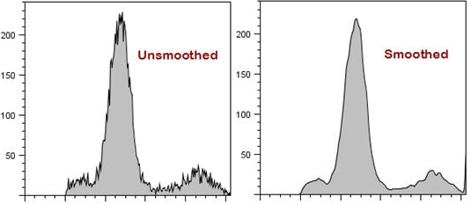
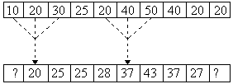
Histogram Smoothing
We can suppress the noise (fake peaks) in the histogram by doing some simple smoothing with a 1D low pass filter (averaging filter)
Other potentially more robust options would be to fit the histogram with a high order polynomial function. Caution should be exercised to make sure the fit is good.

Slide 9
Finding the Threshold – Clustering!
A more robust (and computationally expensive) approach is to treat the problem as a clustering problem.
One way that we can try to do this is to consider the values in the two regions as two clusters.
The idea is to pick a threshold such that each pixel on each side of the threshold is closer in intensity to the mean of the pixels on that side of the threshold than the mean of the pixels on the other side.
There is an algorithm on the next slide for achieving this.

Slide 10
Theresholding by clustering algorithm
Select an initial estimate for T (typically the average grey level in the image)
Segment the image using T to produce two clusters of pixels: C₁ consisting of pixels with grey levels >T and C₂ consisting pixels with grey levels ≤ T
Compute the average grey levels of pixels in C₁ to give μ₁ and C₂ to give μ₂
Compute a new threshold value:
Repeat steps 2 – 4 until the difference in T in successive iterations is less than a predefined limit T∞

Slide 11
Optimal Global Thresholding – Otsu’s method
The algorithm previous works well when the spreads of the modes are similar, i.e. they have similar variance and don’t overlap much.
An even more robust approach is called Otsu Thresholding and finds the threshold by attempting to make the within-class variance (or the combined spread) minimal.
It works by calculating for each possible threshold value (0..255) the variance and the weight (% of total pixels attributed to this class) of each of the two classes.
It then calculates the combined variance of the two classes by multiplying the weight by the variance for each class and adding the result. The threshold value with minimal combined variance is selected – see next slide for an example

Slide 12
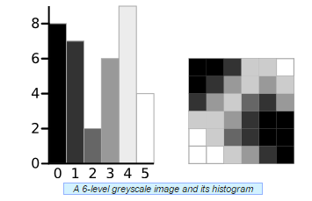
Optimal Global Thresholding – Otsu’s method
Consider this greyscale image and its histogram:

Slide 13
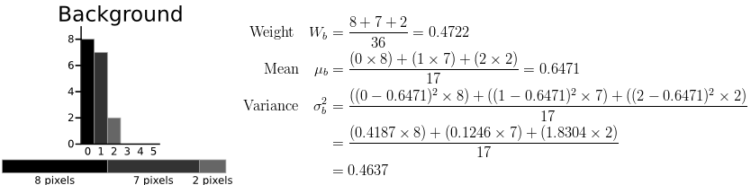
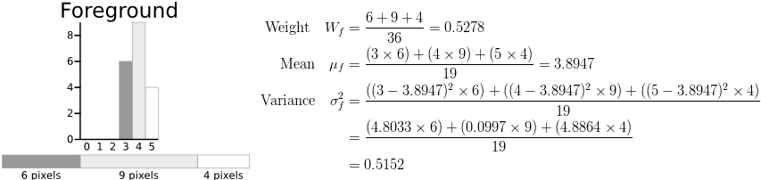
Optimal Global Thresholding – Otsu’s method
Here is the calculation of the combined class variance for t=3:

Slide 14
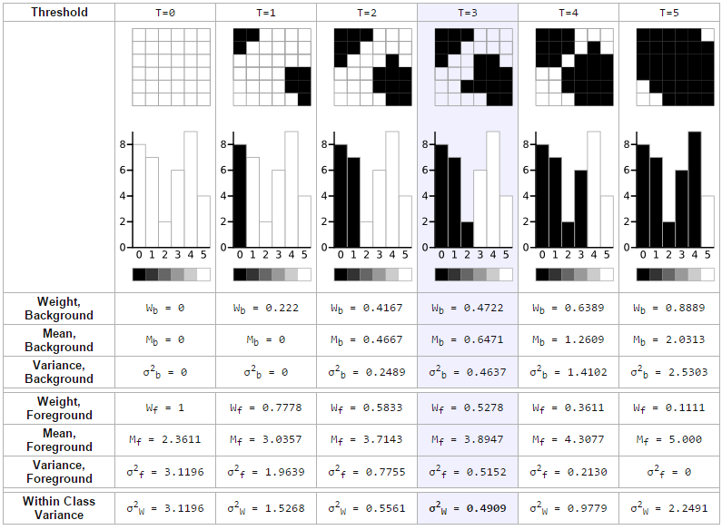
Otsu’s method – Complete Trace

Slide 15
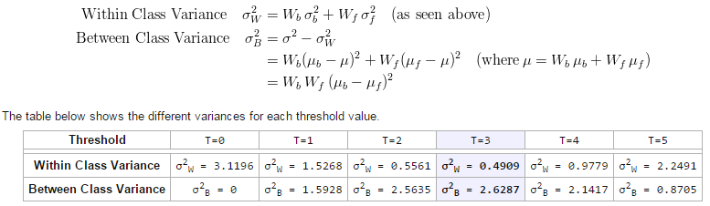
Otsu’s method – speeding it up!
The algorithm on the previous slide is slow. However, you can calculate what is called the between class variance, which is far quicker to calculate and the maximum of this is always the same as the minimum combined class variance.

Slide 16
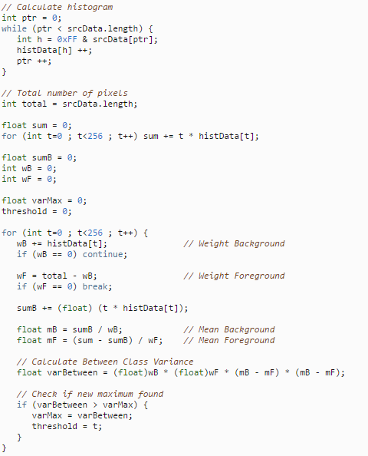
Otsu’s method – Java

Slide 17
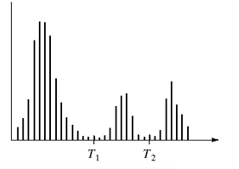
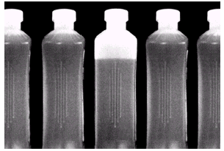
Global Thresholding - Problems
Global thresholding will only work when we have a bimodal histogram with a good valley between the two peaks.
Sometimes there maybe a number of objects in the foreground (possibly spatially connected) with different grey levels. This could give rise to a histogram with more than two peaks.
For this situation we might need to identify more than one threshold to segment the different regions

Slide 18
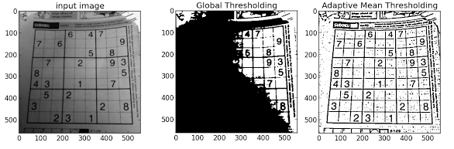
Global Thresholding - Problems
Another issue that frequently arises is uneven illumination across the image which leads to global thresholding problems
One approach to this is to break the image up into sub-images and vary or adapt the threshold for each sub-image

Slide 19



Adaptive (or dynamic) Thresholding
One approach to solving this problem is to calculate the threshold dynamically for each pixel in the image. You can do this by defining a neighbourhood around the pixel (sufficiently large to increase chances of getting background and foreground pixels) and calculating some statistic to use as the threshold in that neighbourhood. Popular choices are the mean-C, median-C, (max-min)/2 etc.
global
adaptive

Slide 20
Histogram Equalisation
While we are on the subject of histograms it is worth looking at histogram equalisation which is more of an image enhancement technique
Frequently you find that most of the grey levels in the image are contained in a narrow band and do not make use of the full 0..255 range
As a result some of the details in the image are not apparent because there is insufficient contrast in that narrow band. A solution to this can be to stretch the range of intensities used to increase contrast.
One such approach to this is histogram equalisation.

Slide 21
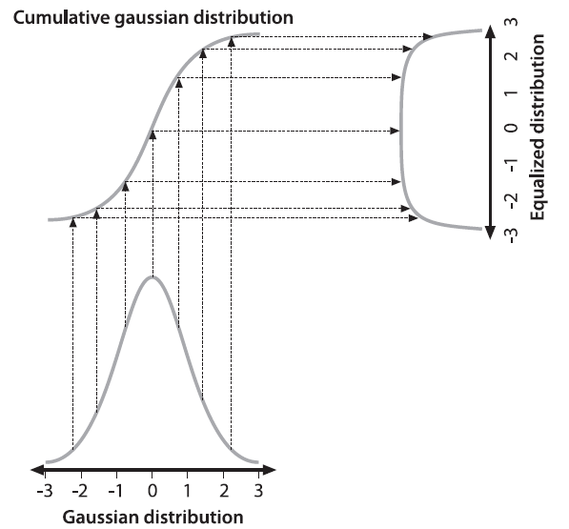
Histogram Equalisation
The idea here is to map the original histogram to a wider and more even one using a mapping function.
It turns out that the cumulative distribution function is a good mapping function for spreading out a distribution
The idealised case of a Gaussian distribution is shown here but this approach will work for any distribution
The cumulative distribution will tell us where each y value of the original distribution will go in the new distribution

Slide 22
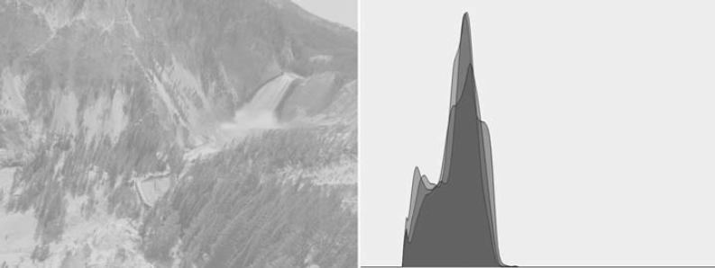
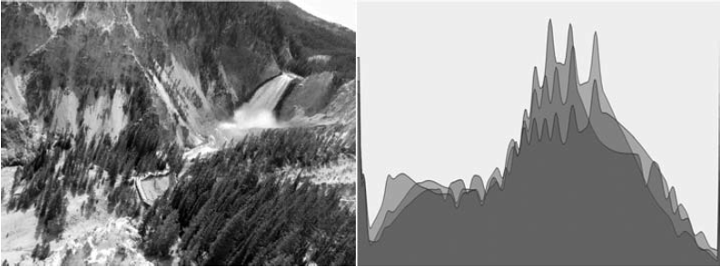
Histogram Equalisation

Slide 23
Binary Morphology
It is frequently the case that you want to enhance or manipulate the binary image produced from thresholding
Maybe you want to fill in some holes? Maybe you want to remove some very small blobs? Maybe you want to make something thinner?
Mathematical Morphology is an area of Mathematics from set theory that can be applied to images to enhance/clean/transform them
Some binary morphological operators are, erosion, dilation, opening, closing, skeletonization

Slide 24
Binary Morphology
Two inputs are required for a binary morphological operator, an input binary image and a structuring element. The structuring element is ‘applied’ to the image in one of a number of ways to produce the output binary image.
There are two properties that determine the outcome.
The composition of the structuring element
The rule that defines how the structuring element is applied to the image.
Binary structuring elements are simply 2D arrays of ones and blanks or zeros. Their size and shape will effect output image.
The process is simple, move/slide the structuring element across and down the image (so its origin is coincident with each pixel) and perform the set operation at each point.

Slide 25
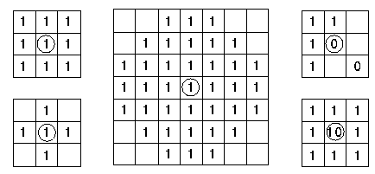
Binary Morphology – Structuring Elements
Structuring elements can be square or rectangular, circular, diamond shaped or whatever shape you like

Slide 26

Binary Morphology – Erosion
The effect of the erosion operator on a binary image is to erode away the boundaries of regions .Thus areas of foreground pixels shrink in size, and holes within those areas become larger.
Let us consider a rectangular structuring element.
To complete erosion we move the structuring element over the image and if every pixel in the structuring element corresponds with the image pixels underneath, then the input pixel is left as it is (1). If ANY of the corresponding pixels in the image are background (0), the input pixel is also set to background value.
So you can imagine foreground pixels on the boundary, these will be set to zero because some of their neighbours will be zero.

Slide 27
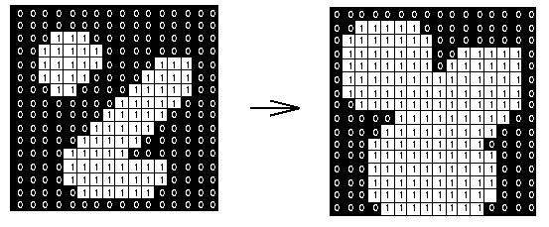
Binary Morphology – Dilation
Dilation is the complement to erosion. We can dilate an image with the same structuring element as erosion.
The difference is what happens at each pixel (the rule applied). If at least one pixel in the structuring element coincides with a foreground pixel in the image underneath, then the input pixel is set to the foreground value.
You can see how this will dilate or expand the region!

Slide 28

Binary Morphology – Closing
One of the uses of dilation is to fill in small holes in images (maybe those that result from noise or unwanted reflections). One of the problems with doing this is that the dilation will also expand the foreground regions.
By performing an erosion on the image after the dilation, i.e. a closing, we reduce some of this effect.
The size of the holes you fill is dependent on the size of the structuring element

Slide 29
Image Segmentation
Image segmentation is the process of partitioning a image into multiple segments (sets or groups of pixels). The goal of segmentation is to simplify and/or change the representation of an image into something that is more meaningful and easier to analyse.
Thresholding is considered a segmentation approach because it can segment an image into background and foreground.
However, normally the foreground objects will need more segmentation (segmentation of the foreground) so we can identify them or make measurements on them
What we need to do is further segment the foreground pixels into groups based on some parameter. Because objects are spatially coherent we can use connectedness as the parameter to group the foreground pixels.

Slide 30
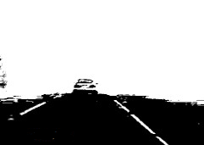
Connected Component Labeling
Consider the following image:
You can see that it is an image of a road that has been thresholded.
Maybe we would like to identify the lines in this image and calculate their mean intensity values or perhaps their thickness?
We need to group the foreground pixels together based on connectedness

Slide 31

Connected Component Labelling
Connected Component labelling is any technique that can traverse the image and assign labels to the groups of pixels that are ‘connected’
Normally we define connected as being 4 connected or 8 connected
So the algorithm will traverse the image until it encounters an unlabelled foreground pixel (white), give this and all pixels connected to it (either directly or through numerous layers of adjacency, think graphs) the same label and then carry on until the end of the image is reached and all foreground pixels have been labelled - it sounds easier than it is!
Various properties (e.g. area, mean/min/max intensity, pixel indexes) of the pixel groups/regions can be calculated and recorded along the way with certain algorithms

Slide 32
Connected Component Labelling
There are a number of different approaches to solving this problem. The most straightforward (imho) is to treat each connected component as a subgraph such that if two pixels are connected then there is an edge between them.
Then as you scan the image when you come across an unlabelled pixel you do a traversal of the connected component or subgraph it belongs to.
As you encounter pixels on the traversal you mark them as being labelled so they won’t be visited again.
When the traversal of that connected component is complete you move onto the next pixel and test it for visitation
As you have seen from data structures the traversal of the connected component can be done by using a suitable data structure, e.g. a queue for a breadth first traversal

Slide 33
Connected Component Labelling - Algorithm
Start from the first pixel in the image. Set "curlab" (short for "current label") to 1. Go to (2).
If this pixel is a foreground pixel and it is not already labelled, then give it the label "curlab" and add it as the first element in a queue, then go to (3). If it is a background pixel, then repeat (2) for the next pixel in the image.
Pop out an element from the queue, and look at its neighbours (based on any type of connectivity). If a neighbour is a foreground pixel and is not already labelled, give it the "curlab" label and add it to the queue. Repeat (3) until there are no more elements in the queue.
Go to (2) for the next pixel in the image and increment "curlab" by 1

Slide 34
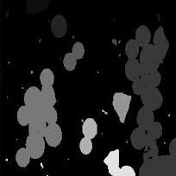
Connected Component Labelling
For visualisation the connected components can be displayed in an image where each components label is a grey level or a different colour

Slide 35
Connected Component (or regions) Properties
So we now have segmented the different regions in our image. If we want to pull out the pixels (intensities and coordinates) for a particular region we can perform a search in our label data structure for pixels that have a particular label
Once we have done that we can calculate a lot of properties for that region that can help us in classifying it as belonging to a particular class of object (e.g. lines on the road)
Some properties are easily calculated
Area – the number of pixels in a region
Perimeter – the pixels in the region that are connected to background or other regions
Centroid – the mean (x,y) image coordinate for the region
Mean/max/min light intensity value
Bounding box and aspect ratio
Extent – The ratio of the region area to the bounding box area

Slide 36

Connected Component (or regions) Properties
Some properties are not so easily calculated:
Orientation - axis of least inertia (see Shapiro pp. 92-93 – linear regression soln?)
Circularity – how circular or is the region?
Where μR and σR are the mean and standard deviation of the distances from the centroid to points on the perimeter
Convex hull – The smallest convex polygon that contains the region
And lots of others……….
Can you think of any other properties of a regions that might be useful?

Slide 37
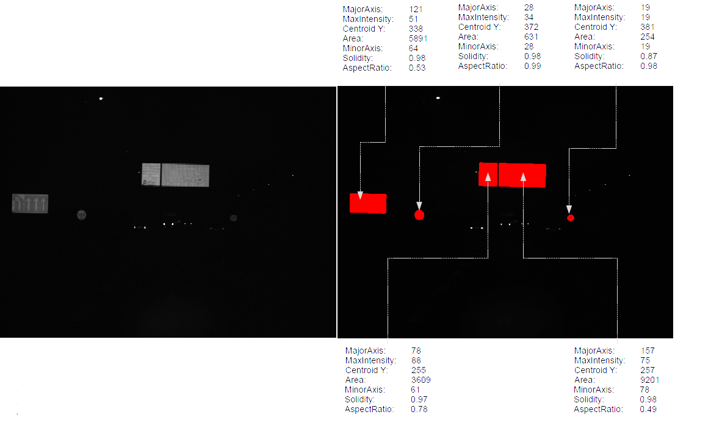
Connected Component (or regions) Properties

Slide 38
Region Properties and Basic classification
When you have calculated the relevant region properties you are in a position to say whether the regions belongs to a particular class or category of object
For example, is it a line on the road? You can answer this question by checking the region properties against upper and lower bounds that are acceptable for that class of object
This will normally involve a set of conditional (if) statements
Machine learning approaches can use the region properties to train a classifier (ANN, SVM) to recognise an object based on its properties or features.

